Slide 1
Sorting Algorithms in Unity
By
Danel P
Jacob P
Sky S

Slide 3
Bubble Sort

Slide 4
Insertion Sort

Slide 5
Quick Sort

Slide 6
Random Sort (Bogosort)

Slide 10
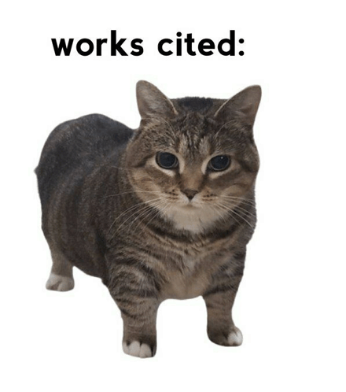
works cited:

